Slide 1

Hiding in Plaintext
10100101001010 1010100101001 111011010111101 011101011101
Jimmy Norman(976690)

Slide 2

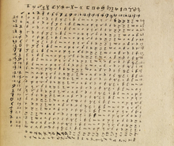
Steganography
The Study of concealment -What? Why? How?(Methods) -‘The What’ Defined as ‘the practice of hiding a secret message in something that is not secret.’ -’The Why’ ‘Concealing interfaces with human perception’ – this can be useful -Next up How?

Slide 3
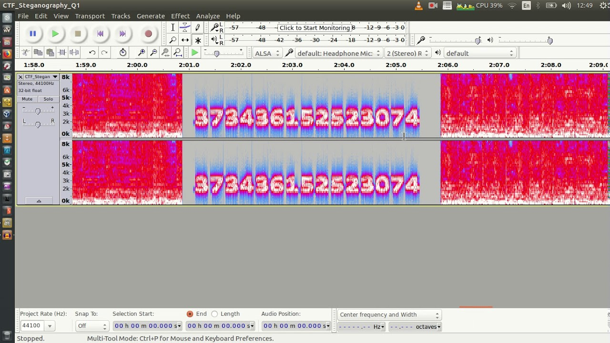

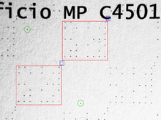
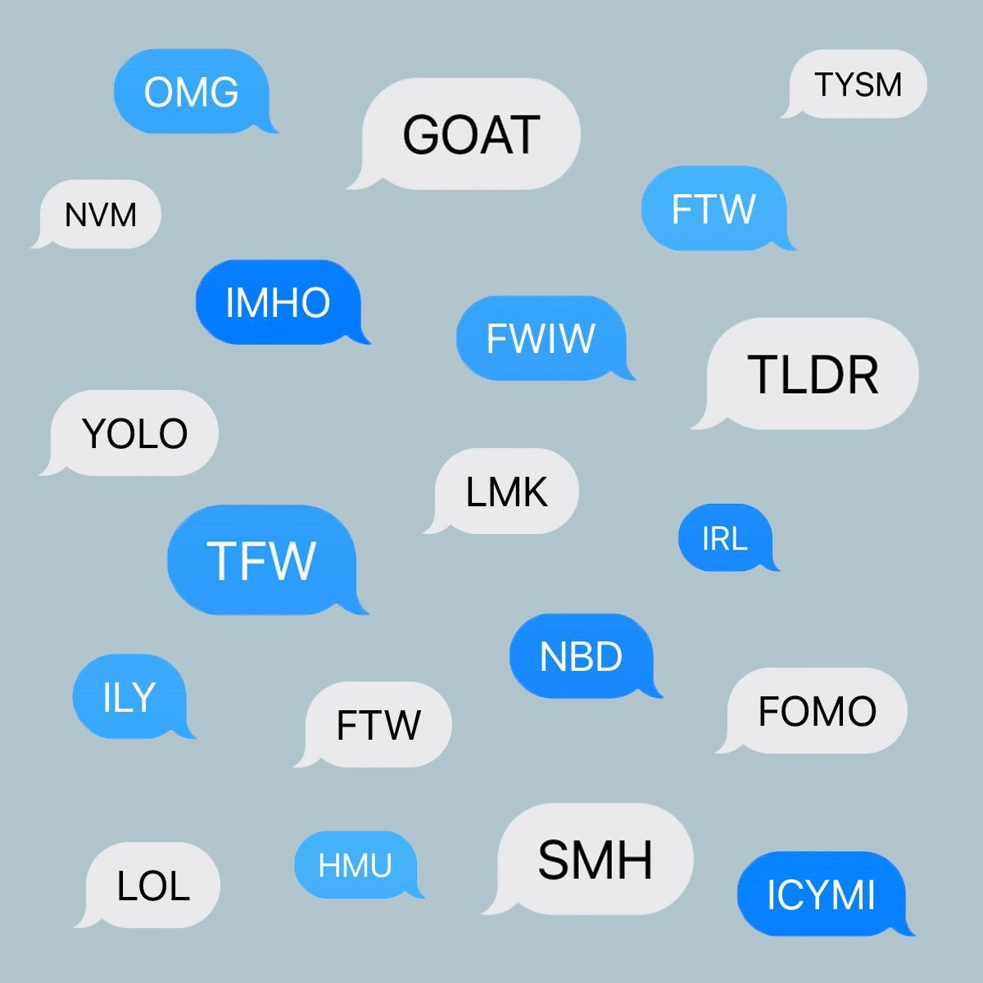
The Flavours of Steganography
Defined personally as three categories with overlap: Digital –Text, Images, Audio
Physical – Paper based, Printed, Invisible ink
Social – Puzzles, Inside jokes, Double meanings
Some more experimental techniques will not precisely fit into these but will inherit characteristics of each.

Slide 4

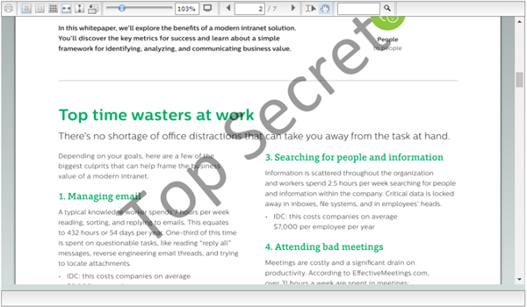


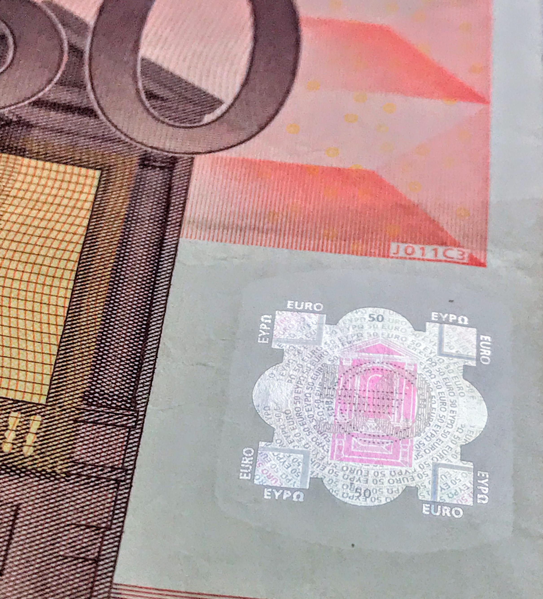
Use Cases
-Watermarking Branding -‘Canary Trap’ -Discrete distribution -Anti-piracy -Security printing
Discrete communications are much better off using encryption instead.

Slide 5

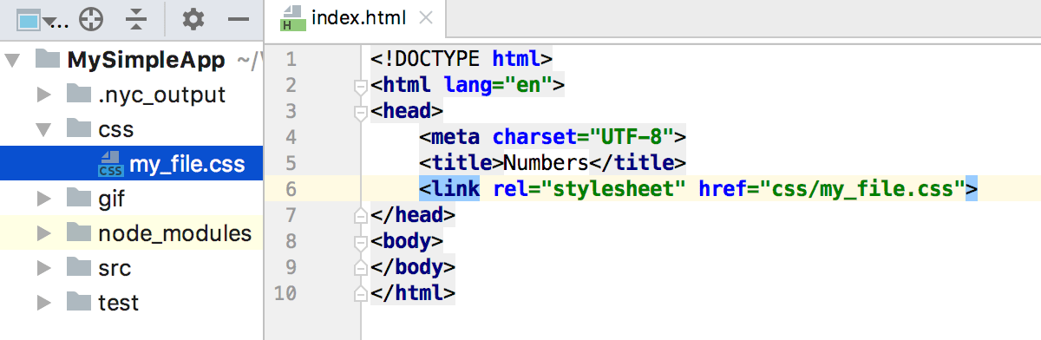
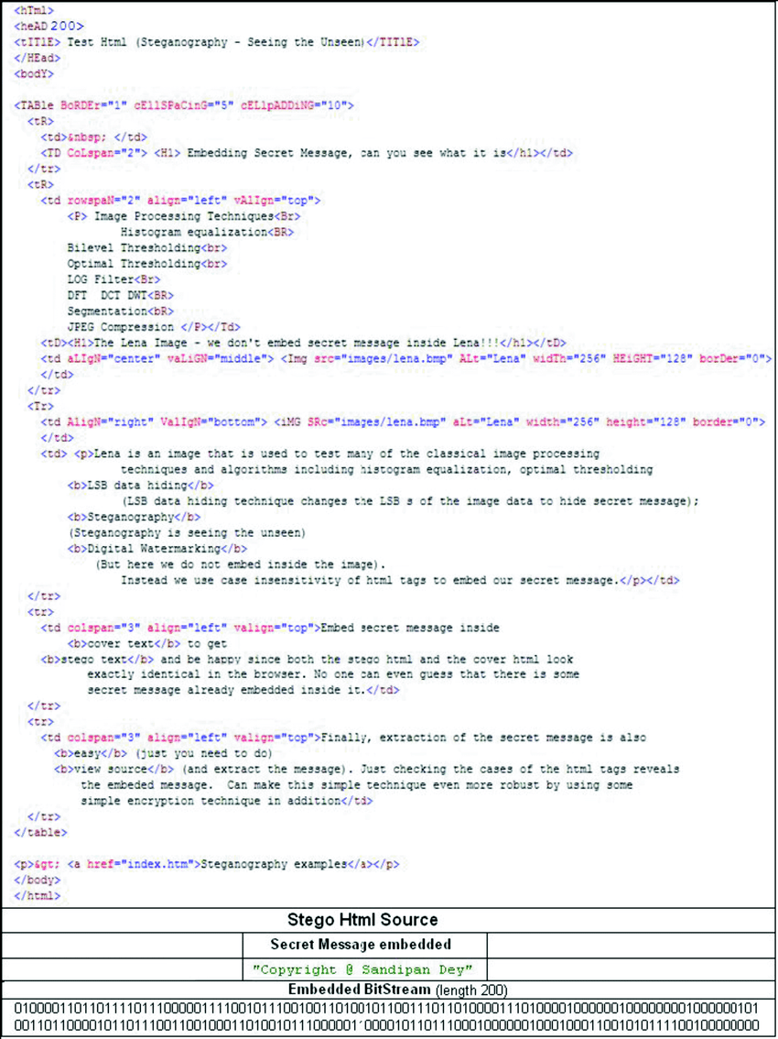
My project: HTML based
To conceal a message within a HTML Original method GUI/Saving/Loading Ease of use Builds upon existing information

Slide 6


Similar Projects/Research
Existing projects serve as research and inspiration [1] Garg, M. G. (2011). A Novel Text Steganography Technique Based on Html Documents. [2] Odeh A., Elleithy K., Faezipour M., Abdelfattah E. (2015) Novel Steganography over HTML Code. [3] Shahreza M.S. (2007) A New Method for Steganography in HTML Files. More general research into variety of digital techniques [4] Shaw, U. S., & Medhi, S. P. M 2017 IEE conference

Slide 7

Findings
Key Distinction Steganography and Cryptography Three main categories with overlap Still Useful in modern applications Digital techniques are well explored and researched Contributing a unique HTML scheme

Slide 8

Thanks for watching Any questions?
?

Slide 9
References
[1] Garg, M. G. (2011). A Novel Text Steganography Technique Based on Html Documents. International Journal of Advanced Science and Technology, 35(1), 129–138. http://citeseerx.ist.psu.edu/viewdoc/download?doi=10.1.1.445.2007&rep=rep1&type=pdf [2] Odeh A., Elleithy K., Faezipour M., Abdelfattah E. (2015) Novel Steganography over HTML Code. In: Sobh T., Elleithy K. (eds) Innovations and Advances in Computing, Informatics, Systems Sciences, Networking and Engineering. Lecture Notes in Electrical Engineering, vol 313. Springer, Cham. https://doi.org/10.1007/978-3-319-06773-5_81 [3] Shahreza M.S. (2007) A New Method for Steganography in HTML Files. In: Elleithy K., Sobh T., Mahmood A., Iskander M., Karim M. (eds) Advances in Computer, Information, and Systems Sciences, and Engineering. Springer, Dordrecht. https://doi.org/10.1007/1-4020- 5261-8_39 [4] Shaw, U. S., & Medhi, S. P. M. (2017, March). Linguistic Grammar Approach to Textual Steganography. In Bharati Vidyapeeth’s Institute of Computer Applications and Management (BVICAM) (Ed.), 11th INDIACom; INDIACom-2017; IEEE Conference (pp. 1671–1675). IEEE.IEEE ID 40353

